Slide 1
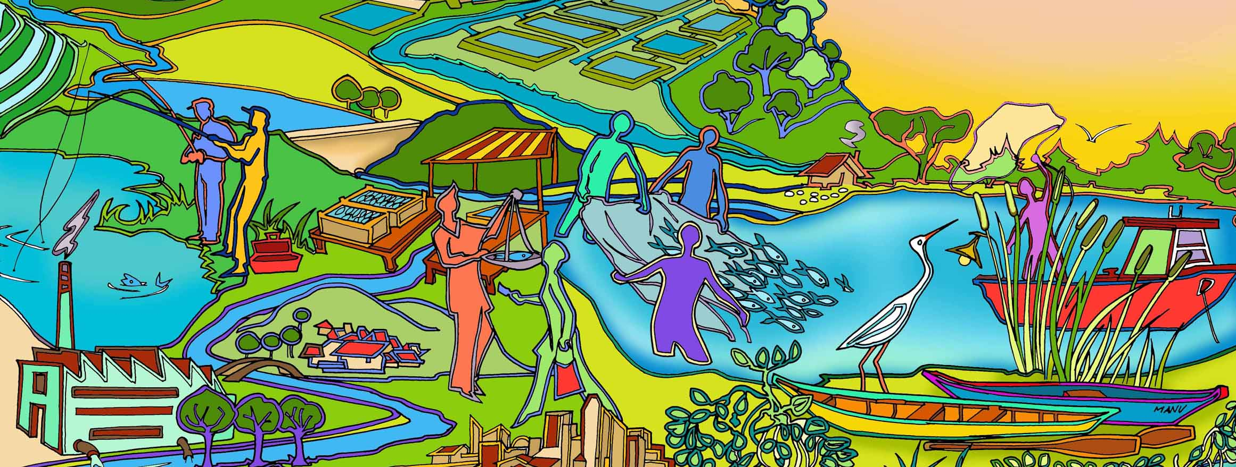
Session 1 Essential EAFm course overview
Essential EAFm training
Date |Place
Notes:
See Session Plan for details as there are many activities that trainers have to manage in this session which are not related to the slide set. Starting from registration (in fact the

Slide 2
Overall course objective
Understand the concept and the need for an Ecosystem Approach to Fisheries management (EAFm)
Learn skills and knowledge to more sustainably manage inland capture fisheries
Notes:
These are the overall course objectives.
Firstly participants will understand what EAFm is and secondly, be able apply it through developing and implementing an EAFm plan.
This course focuses on inland capture fisheries but all the principles and activities can also apply to marine fisheries, and even aquaculture.

Slide 3
This course will equip you to:
Manage fisheries more holistically
Resolve fisheries issues and challenges better
Work cooperatively with other stakeholders
Reduce user group conflicts
Make financial resources available
Increase political will and support
Notes:
Self explanatory
Note:
Manage fisheries more broadly
Negotiate with stakeholder and reduce conflict
Improve money available

Slide 4
EAF or EAFm?
EAF: Ecosystem Approach to Fisheries.
Applies the ecosystem approach to fisheries
Broad concept that covers development, planning, food safety, etc.
EAFm: Ecosystem Approach to Fisheries management.
Applies the ecosystem approach to fisheries management
This course focuses on inland fisheries management i.e. EAFm

Slide 5
For this course…………
We will be looking at inland fisheries in [Insert region/country]
Note: Ecosystem approach can also be applied to other systems e.g. coastal and offshore marine ecosystems or even aquaculture systems
Notes:
Note to trainers: ENSURE YOU CHANGE THE COUNTRY/ REGION TO REFLECT THE CONTEXT
After these introductory slides you are going to do the threats and issues activity.
Show this slide to focus this course on inland fisheries in Africa: (this is to set the context, ensure we are all on same footing).
Could be changed to marine, etc. as the principles are the same.

Slide 6
 | DAY 1 What & why | DAY 2 How | DAY 3 Plan & check | DAY 4 Do & check | DAY 5 Present
Morning 08.30 –10.10 | Registration Introductions Course overview 1. Threats and issues in fisheries | 5. Moving towards EAFm Lake Victoria case study | 10. Step 1: Define & scope the Fishery Management Unit (FMU) 1.1 Define the FMU 1.2 Agree on the vision 1.3 Scope the FMU | 13. Step 3: Develop the EAFm plan 3.1 Develop management objectives 3.2 Develop indicators and benchmarks | Quiz review Participant work: refining EAFm plans & preparing presentations
Break
10.30 – 12.30 | 2. Fisheries management and the ecosystem approach 3. The what and why of EAFm? | 6. EAFm plans: the link between policy and action 7. EAFm process overview 8. Startup A Preparing the ground | 11. Step 2: Identify & prioritize issues & goals 2.1 Identify FMU-specific issues 2.2 Prioritize issues 2.3 Define goals 12. Reality check I Constraints and opportunities | 14. Step 3: Develop the EAFm plan …cont’d 3.3 Agree management actions 3.4 Include financing mechanisms 3.5 Finalize EAFm plan 15. Step 4: Implement the plan 4.1 Formalize, communicate and engage | Participant presentations on EAFm key elements to illustrate learning Feedback on presentations
Lunch
Afternoon 13.30 –14.45 | 4. Principles of EAFm | 8. Startup A Preparing the ground cont. | 12. Reality check I Facilitation skills | 16. Reality check II Align to EAFm principles Supporting environment | Course review Individual action planning
Break
15.05 –16.30 17.00 wrap up | (4a) How much EAFm are you already doing? | 9. Startup B Engaging stakeholders | 12. Reality check I Conflict management | 17. Step 5: Monitor, evaluate and adapt 5.1 Monitor and evaluate performance 5.2 Review and adapt the plan EAFm QUIZ | Course evaluation Course closure and certification
 | Homework: EAFm progress |  |  | Homework: Presentation preparation
Notes:
Refer participants to hard copy (Introduction section in handbook) and run through the 5 days briefly, sharing a bit of what they will do each day that will include presentations, activities with plenty of time for discussions.
DO NOT SPEND TOO MUCH TIME ON THIS. THE PURPOSE IS SHOW THEM THAT THERE IS A STRUCTURE.

Slide 7
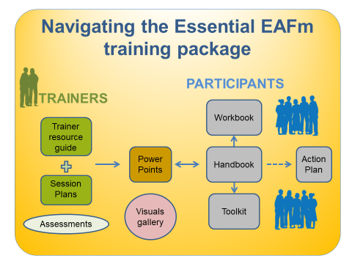
Materials and feedback
Course Handbook, Workbook, Toolkit
Take-home PowerPoint slides & resources
Daily monitoring and review
Course evaluation
Certificates
Notes:
The participants will receive (i) course handbook (i.e. all the written modules), that contains a glossary and all the modules (ii) Workbook (blank; following the EAFm steps, which they complete as they go along and use to draft their EAFm Plan) and (iii) a Toolkit. They will get PowerPoints and resources on CD/ USB at end of course. There will also be daily monitoring and review, course evaluation and certificates. Get participants to find each in turn (from materials they have been given) and for the Handbook: explain symbols (In the handbook ☺ means word is in glossary); highlights mean cross referencing within Handbook and with Toolkit. Explain modules in Handbook follow course sequence.
For the Workbook: explain function is for participants to record their individual/ group work, which they can then collate to develop draft EAFm plan for day 5.
Toolkit: section A is People skills; section B (longer) is Technical skills.

Slide 8
New ways of learning
Learning new skills and elaborating on what you already know
Reading, seeing, listening and questioning
Hands-on activities and exercises and relating to your own experience
Sharing tips and experiences
Having fun!
Useful resource for EAFm = FAO EAFNet online Toolkit
http://www.fao.org/fishery/eaf-net/topic/166272/en
Notes:
Explain very briefly that each of us has a preferred way of learning and that this course caters for all those ways, including building on what they already know, reading and questioning, hands-on activities and sharing.
A useful resource, especially after the course, is EAFNet online Toolkit available by Googling.

Slide 9
Turning your learning into action
Daily action planning
Working in groups
Presentations on day 5
Notes:
This is the last slide you show as part of the course overview.
Explain: Action Planning Booklets allow participants to note down key messages and outputs from activities to be used later (ideally 5 minutes before lunch and at end of day).
Presentations day 5 are way of embedding learning and presenting a tool/ aspect which they will use back in workplace (preferably in clusters) (so be thinking about this as we go through the course).
Now do the icebreaker activities explained in session plan (years of experience line & participant mapping).

Slide 10
Group activity
Discuss threats or issues relating to your fisheries and the associated ecosystem
Write each issue or threat on a SEPARATE card, think of as many as you can
Place the cards on the flipchart
Move around so you can see other group’s work
Note: You will be using these cards again later
Notes:
This is the 1st of many group activities throughout the course. See session plan for details.
For now, use random groups.
Aim of activity is:
to come up with relevant issues and threats which participants will work with after lunch and later on in course, and
as an icebreaker, so participants get talking to each other and get to know a smaller group of other participants in more depth.
Groups discuss and write threats and issues on cards. Then they stick cards onto flipchart spread on tables or on wall. It is up to the groups if they want to cluster issues in way they want. Trainers can feed issues into discussions if groups get stuck
Definitions:
Threat= A danger/ a problem
Issue = something that impacts on your fishery
A lack of something in place can also be an issue.

Slide 11
Key messages
Many threats and issues to sustainable inland fisheries
You will already be familiar with many of these
Issues are the same across many parts of the world
Some are within the fishery, others come from outside
Some are trans-boundary
Regional cooperation will help address the issues
Countries can learn from each other

